Slide 1

2025

Slide 2
COACHING STAFF
Offense
James Barnard - Offensive Coordinator
Robby Case - Sp. Teams Coord./QB/WR
Marquis Mosley - Wide Receivers
Shamari Brooks - Running Backs
Terrance Lovely - TE/H-Backs
Drake Centers - Offensive Line
Corben Henry - Offensive Line
Defense
Brody Trahan – Associate HC/Defensive Coordinator
Charles Moss - Defensive Line/Run Game Coord.
Brandon Nava - Defensive Line
Jerod Brown - Linebackers
Makyle Sanders - Safeties
Mike Jones - Cornerbacks
Elijah McQueen - Nickel Safeties
Beau Trahan - Head FB Coach/Campus Coordinator
Colin Shillinglaw - Asst. Campus Coordinator-Operations
Dan Huebsch - Football Strength Coach/Director of FB Operations
Casey Cockrell - Character Coach

Slide 3
ATHLETIC TRAINING STAFF
Head Athletic Trainer – Amy Langley
Assistant AT – Aaron Gibson
Assistant AT – Abbey Lowery
Assistant AT – Ashley Coker
Assistant AT – Laura Barker
Team Physician – Dr. Arizpe

Slide 4
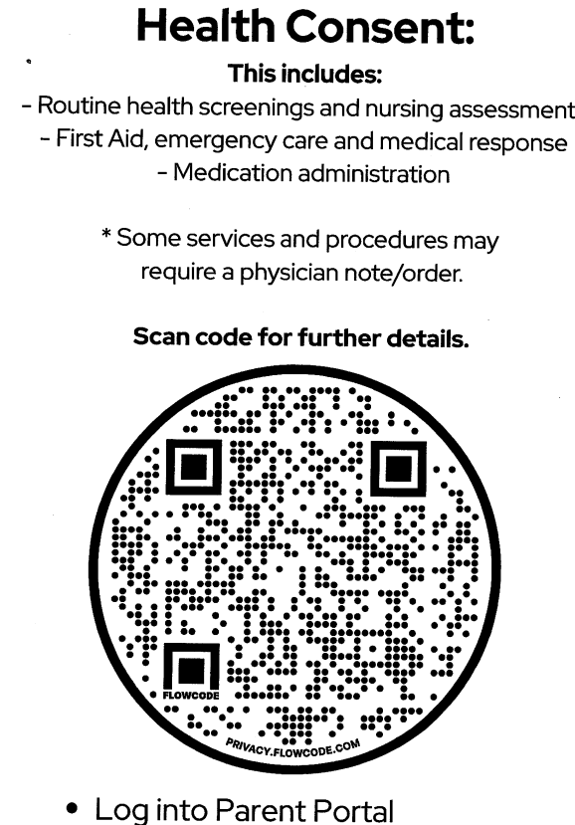

Slide 5

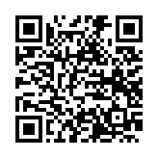
COMMUNICATION WITH PARENTS
This app is used for daily schedule changes, weather, information, etc.
All Parents
Code:QUDF-XWXW

Slide 6


COMMUNICATION WITH PARENTS & PLAYERS
This app/website is used for season schedules, all forms, & other information.

Slide 7
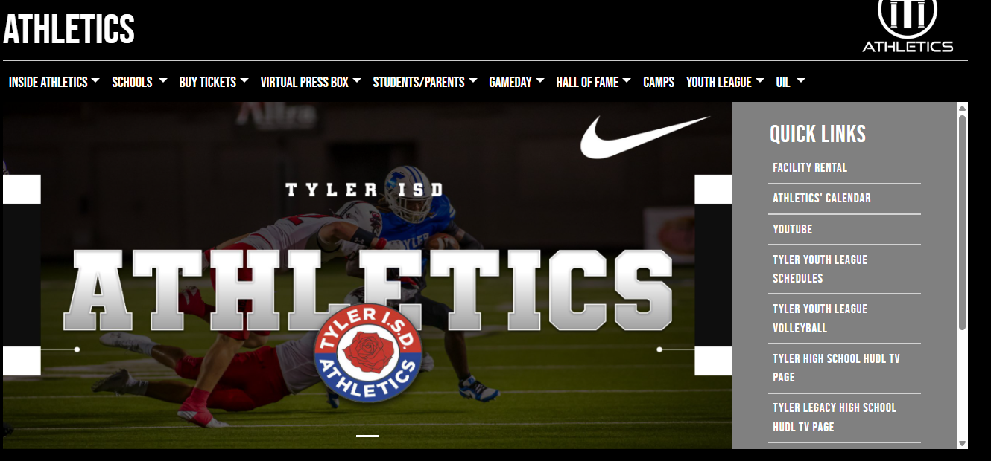
Tyler Legacy Athletics Website
Tyler ISD Athletics Website

Slide 8
TICKETS FOR GAMES
Posted online at Tickets
Click on “TICKETING”
Click on “TICKET INFORMATION AND PRICES”

Slide 9
CRITERIA FOR TEAM SELECTION
(FRESHMAN – JV – VARSITY)
Football is a no cut sport but… attendance, behavior, and grades can be grounds for removal from the program.
Everyday, players are evaluated based on multiple individual drills, group sessions, and team scenarios as well as attitude, effort, and classroom behavior. We will hold our athletes to the highest standard for success after football.
We as a coaching staff try to put players in the best position to benefit the student athlete and our program.
In sub-varsity games all players will have the opportunity to play in the game, as long as they are in good standing.

Slide 10
LOCKER ROOM MANAGEMENT
NO CELL PHONES IN LOCKER ROOM (District Policy)
Locks are mounted on lockers, LOCK UP YOUR THINGS!

Slide 11
Team Rules
No Stealing – Zero Tolerance
Respect Women, Teachers, and Positions of Authority
Consequences to all choices made both good and bad

Slide 12
PARENT-COACH MEETING
CHAIN OF COMMAND
POSITION COACH
HEAD COACH (BEAU TRAHAN)
ATHLETIC DIRECTOR (Sam Gillispie)
48 HOUR RULE (POST GAME)
NO TALK ABOUT PLAYING TIME
NO TALK ABOUT ATHLETES OTHER THAN YOUR SON

Slide 13
TRANSPORTATION TO/FROM EVENTS
  Players will act appropriately to and from games.
Players will ride the bus to and from games, unless prior arrangements have been made. (Emergencies Only)
(Varsity Home Games) Per District Policy, Post Game - Please do not meet at the fence or field at Rose Stadium. Meet your son at the Tyler Legacy High School Field House.

Slide 14
AMATEUR ATHLETIC RULE
The amateur rule starts the first class day of a student’s ninth grade year, and is in continuous effect during the school year and summer months until all athletic competitions are completed in the 12th grade. The student at all times (whether in school or outside school) shall abide by the letter and intent of amateurism, as set forth in this section. Schools are charged with the responsibility of informing students of all applicable subsections of this rule and enforcing this rule. Administrators and coaches must ensure that athletes receive only services specifically permitted by written rule. Any breach of the rule undermines the educational goals of interscholastic athletics.
(a) NOT AN AMATEUR. For purposes of competing in an athletic contest, a student in grades 9-12 is not an amateur if that individual, within the preceding 12 months:
(1) except as provided otherwise in this section, received money or other valuable consideration for participating in a UIL sponsored school sport;
(2) received valuable consideration for allowing his or her name to be used in promoting a product, plan or service related to a UIL sport or contest; or
(3) accepted money or other valuable consideration from school booster club funds for any non-school purpose.
(4) For the purposes of this section, “participating” means taking part or playing any role in the covered sport or otherwise being involved in any practice, game or contest of the covered sport, as a coach, player, manager, assistant, or any other involvement besides that of a spectator. A game or activity involving chance not sponsored by the UIL but that may also involve a student using some athletic skill or ability does not constitute “participating” under this section. Such a game or activity would be a “half-court shot” contest as part of a marketing program or throwing balls at a target for a prize. “Teaching” and ‘coaching” are synonymous terms.
(5) For the purposes of this section a “UIL sponsored school sport” is any sport that is sponsored by the UIL as either a regular approved UIL activity or pilot program and that is made available through the school the student attends. For example, baseball is a UIL sponsored sport and is covered by this rule, regardless of the level of competition involved or organization that is administering the game in which the sport is played.

Slide 15

UIL ELIGIBILITY RULE
Subject to the other sections of this subchapter, an individual is eligible to participate in a UIL varsity contest as a representative of a member school if that individual:
(a) is not a high school graduate (Refer to Section 405);
(b) is a full-time, day student in the member high school the student represents; or is a non-enrolled (home schooled) student seeking participation and is in compliance with all provisions included in section 33.0832 of the Texas Education Code (Refer to Section 406, academic exception, Official Interpretations 08-09-10, 99-04-20, 10-03-12 and 00-09-13, Appendix I).
(c) has been in regular attendance at the member school since the sixth class day of the present school year or has been in enrolled and in regular attendance for 15 or more calendar days before the contest or competition (student becomes eligible on the fifteenth day) (Refer to Section 407 and Official Interpretation 95-11-09, Appendix I);
(d) is in compliance with rules of the State Board of Education; (Refer to Section 404 and state law regarding credit requirements and grades (the school shall verify a student’s grades on the basis of the official grade report and independently of involvement by the student);
(e) has the required number of credits for eligibility during the first six weeks of school (Refer to Section 411);
(f) is enrolled in a four-year program of high school courses (Refer to Section 408);
(g) initially enrolled in the ninth grade not more than four years ago nor in the tenth grade not more than three years ago (Refer to Section 408 and Official Interpretation 07-04-18, Appendix I);
(h) was not recruited (Refer to Section 5 and Section 409);
(i) is not in violation of the Awards Rules (Refer to Section 480);

Slide 16
GRADING PROCEDURES – ACADEMIC EXPECTATIONS
NO PASS – NO PLAY
UIL SIDE BY SIDE POLICY (6 WEEKS / 9 WEEKS)
TISD POLICY – MUST BE PASSING AT 9 WEEKS

Slide 17
Sportsmanship Expectations for Fans
Behavior Expectations of Spectators
• Always support your team and the efforts of all participants involved.
• Do not intimidate or ridicule a player, coach, or official before, during or after a contest.
• Always praise athletes for their actions during a game; never degrade a participant for their efforts. Athletics are a learning experience for students, and mistakes will be made.
• A ticket is a privilege to observe the contest, not a license to verbally assault others or be generally obnoxious.
• Learn the rules of the game so that you may understand and appreciate why certain situations take place.
• Always respect the integrity and judgment of officials. They are present to regulate the flow and enforce the rules of the game. An official should never be degraded or ridiculed for a call they make.
• Show respect for the opposing players, coaches, spectators and support groups. Treat them as guests to your school.
• Use only cheers that support and uplift the teams involved.
• Recognize and show appreciation for an outstanding play by either team.
• Refrain from the use of any controlled substance (alcohol, drugs, etc.) before, during and after the game, on or near the site of the event (i.e. tailgating).
• Be a positive role model at events through your own actions and by censuring those around you whose behavior is unbecoming.
“THE TEXAS WAY”

Slide 18
COACHING PHILOSOPHY
OFFENSE – DEFENSE – SPECIAL TEAMS
MULTI-SPORT ATHLETES

Slide 19
NEW RULES
Two Minute Timeout at the end of each half (2nd/4th Qtrs)
Overtime Timeouts
Guardian Caps - https://guardiansports.com/guardian-caps/

Slide 20
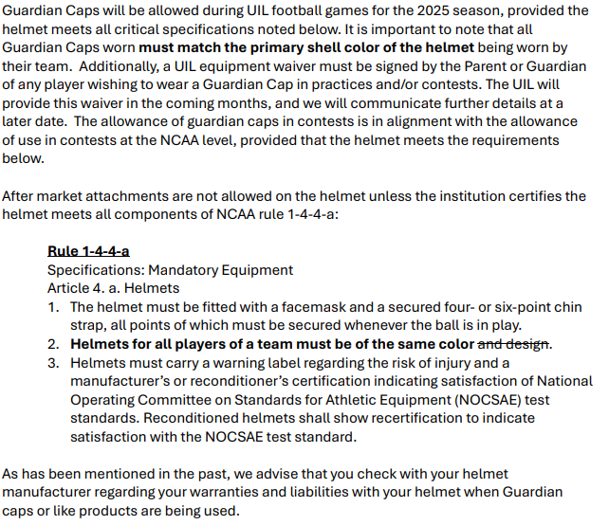
GUARDIAN CAPS

Slide 21
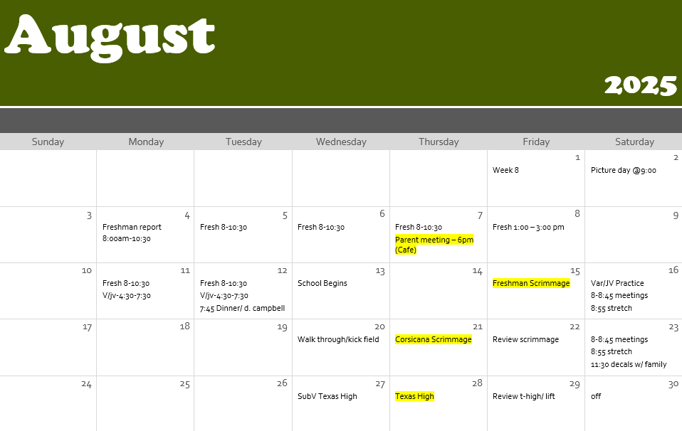
PRACTICE
SCHEDULE

Slide 22





RECRUITING
PROGRAM USED TO PROMOTE OUR PLAYERS
PROGRAM USED FOR FILM / HIGHLIGHTS

Slide 23

Making your highlight tape
Include your BEST highlights
Keep your highlight video between 3-5 minutes in length and if a college coach requests to see footage of a whole game, then you’ll know to deliver a longer video to them.
Put your top clips at the beginning of the highlight video. The first 20 -30 seconds of your video are crucial in holding the attention of college coaches.
Use freeze frames and spot shadows in your edit so coaches can see the play you’re about to make.
Vary the athletic skills you showcase. Variety of top highlights is key to showcase a broad range of abilities and keep college coaches watching with anticipation.
Include footage from before and after the play.
Provide detailed athlete information at the beginning of the highlight video with an introduction. Include your name, school, jersey number, position, graduation year and contact information

Slide 24
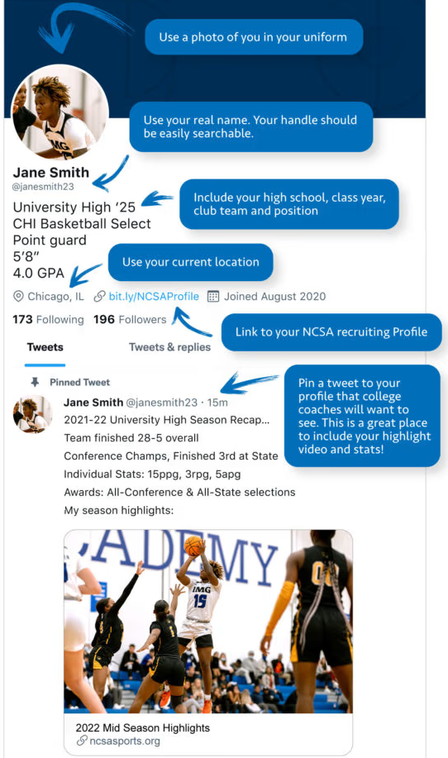
Twitter “X”
Use X to your advantage
DM coaches on your list. Make sure your DMs are open.
Be careful what you Like/Tweet/Retweet
Tag a college coach on your athletic tweets

Slide 25
FOOTBALL CLUB OFFICERS
President – Chris Boone
Vice President – Clint Harris
Secretary – Branson Parker
Treasurer – Jill Boone

Slide 26
Tyler Legacy Head Football Coach: Beau Trahan
Email: beau.trahan@tylerisd.org
Phone: 903-262-2670
Important Website:
www.tylerisd.org (Click on athletics to locate policies for District / UIL)

